Slide 1
ETHICAL AND SOCIAL ISSUES IN INFORMATION SYSTEMS
Management Information Systems
Chapter 4 Ethical And Social Issues In Information Systems
@2012 by Prentice Hall

Slide 2
CHAPTER 4: ETHICAL AND SOCIAL ISSUES IN
INFORMATION SYSTEMS
Learning Objectives
What ethical, social, and political issues are raised by information systems?
What specific principles for conduct can be used to guide ethical decisions?
Why do contemporary information systems technology and the Internet pose challenges to the protection of individual privacy and intellectual property?
How have information systems affected everyday life?
© Pearson Education 2012
Notes:
Ask students what their first impressions are after seeing these objectives. Can they point to examples of how information systems have affected everyday life? If not, explain that they will be surprised to learn that information systems affect almost every area of daily life. Can students explain how the Internet poses challenges to privacy and intellectual property? Ask them how Google, Facebook, and peer-to-peer networks are related to these issues. What about breakdowns in important networks and software at banks, air traffic control, and other business firms?

Slide 3
CHAPTER 4: ETHICAL AND SOCIAL ISSUES IN
INFORMATION SYSTEMS
Understanding Ethical and Social Issues Related to Systems
Recent cases of failed ethical judgment in business
  Lehman Brothers, Minerals Management Service, Pfizer
  In many, information systems used to bury decisions from public security
Ethics
  Etika: sebuah prinsip benar dan salah yang digunakan seseorang, yang bertindak sebagai pelaku moral yang bebas, untuk membuat keputusan untuk mengarahkan perilakunya.
© Pearson Education 2012
Notes:
There are numerous examples of business ethical failures to ask students about. You could ask how information systems or their absence might have been related to the current financial crisis in the United States, the investment banks that have suffered heavy losses, and individuals who were able to defraud investors of millions. What role did IS have in this crisis? The Madoff Ponzi scheme is instructive: systems were used for over twenty years to fool investors, regulators, and investigators about the true nature of Madoff’s business.

Slide 4
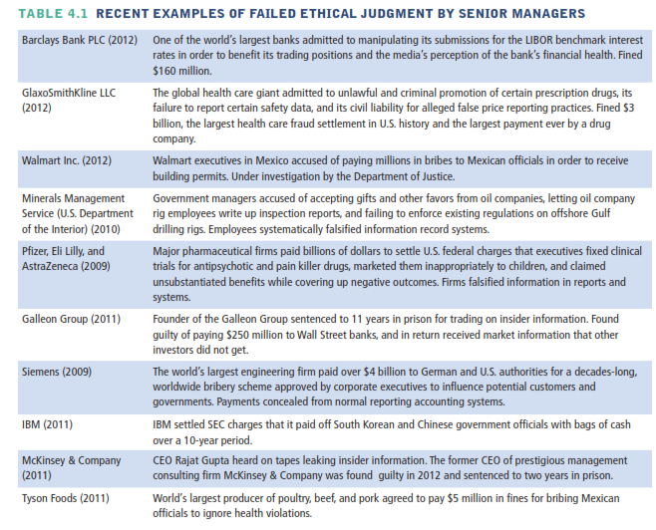
© Pearson Education 2012

Slide 5
CHAPTER 4: ETHICAL AND SOCIAL ISSUES IN
INFORMATION SYSTEMS
Understanding Ethical and Social Issues Related to Systems
Information systems and ethics
  Information systems raise new ethical questions because they create opportunities for:
    Intense social change, threatening existing distributions of power, money, rights, and obligations
    New kinds of crime
© Pearson Education 2012
Notes:
Ask students to describe some of the ethical dilemmas that are presented by information systems and new developments in technology. Privacy is an important issue – mention the opening case again and explain that Google, Facebook, and other similar sites often run into trouble regarding privacy invasions.

Slide 6
CHAPTER 4: ETHICAL AND SOCIAL ISSUES IN
INFORMATION SYSTEMS
Understanding Ethical and Social Issues Related to Systems
Model for thinking about ethical, social, political issues:
  Society as a calm pond
  IT as rock dropped in pond, creating ripples of new situations not covered by old rules
  Social and political institutions cannot respond overnight to these ripples—it may take years to develop etiquette, expectations, laws
    Requires understanding of ethics to make choices in legally gray areas
© Pearson Education 2012
Notes:
Can students provide any examples of how IT has challenged some area of ethics, social life, or legal arrangements?

Slide 7
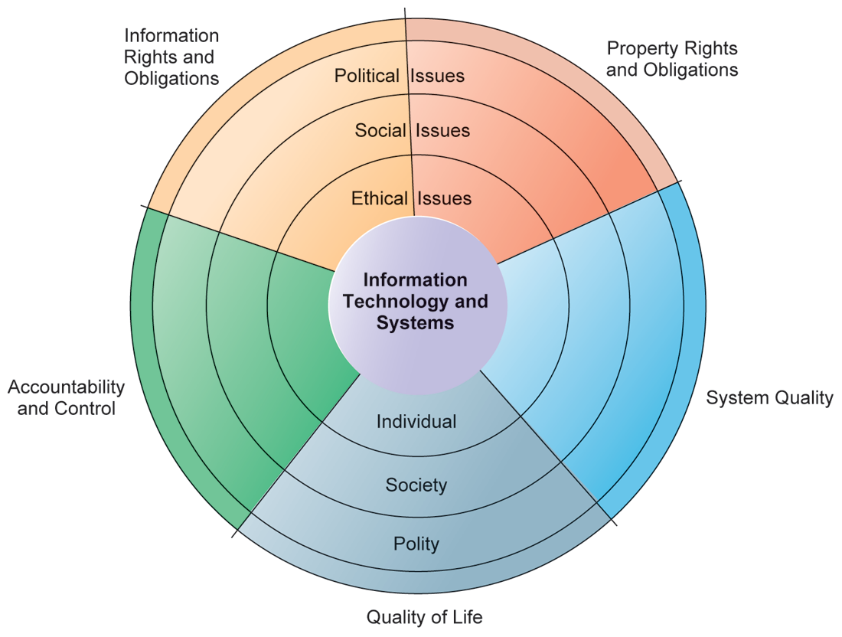
CHAPTER 4: ETHICAL AND SOCIAL ISSUES IN
INFORMATION SYSTEMS
Understanding Ethical and Social Issues Related to Systems
THE RELATIONSHIP BETWEEN ETHICAL, SOCIAL, AND POLITICAL ISSUES IN AN INFORMATION SOCIETY
The introduction of new information technology has a ripple effect, raising new ethical, social, and political issues that must be dealt with on the individual, social, and political levels. These issues have five moral dimensions: information rights and obligations, property rights and obligations, system quality, quality of life, and accountability and control.
FIGURE 4-1
© Pearson Education 2012
Notes:
Explain to students that the graphic displays the five moral dimensions listed in the caption. Consider online p2p shared music as an example of how a new technology has ethical, social, and eventually political (legal) ramifications. If music can be ripped off, why pay any money for it? Why should anyone care about record labels or artist’s income?

Slide 8
CHAPTER 4: ETHICAL AND SOCIAL ISSUES IN
INFORMATION SYSTEMS
Understanding Ethical and Social Issues Related to Systems
Five moral dimensions of the information age
  Information rights and obligations
  Property rights and obligations
  Accountability and control
  System quality
  Quality of life
© Pearson Education 2012
Notes:
Give examples of each of the five major issues. For example, an issue dealing with information rights might be, “What rights do individuals possess with respect to themselves?” What do they have a right to protect? An issue dealing with quality of life might be, “What values should be preserved in an information- and knowledge- based society?” An issue dealing with system quality might be, “What standards of data and system quality should we demand to protect individual rights and the safety of society?”

Slide 9
CHAPTER 4: ETHICAL AND SOCIAL ISSUES IN
INFORMATION SYSTEMS
Understanding Ethical and Social Issues Related to Systems
Key technology trends that raise ethical issues
  Doubling of computer power
    More organizations depend on computer systems for critical operations
  Rapidly declining data storage costs
    Organizations can easily maintain detailed databases on individuals
  Networking advances and the Internet
    Copying data from one location to another and accessing personal data from remote locations is much easier
© Pearson Education 2012
Notes:
This slide and the next discuss four main technology trends that raise ethical issues. Which of these trends do students believe might have the most adverse consequences? Why do they feel this way? Do the positives outweigh the negatives for all four issues? Why or why not?

Slide 10
CHAPTER 4: ETHICAL AND SOCIAL ISSUES IN
INFORMATION SYSTEMS
Understanding Ethical and Social Issues Related to Systems
Key technology trends that raise ethical issues (cont.)
  Advances in data analysis techniques
    Companies can analyze vast quantities of data gathered on individuals for:
      Profiling
        Combining data from multiple sources to create dossiers of detailed information on individuals
      Nonobvious relationship awareness (NORA)
        Combining data from multiple sources to find obscure hidden connections that might help identify criminals or terrorists
© Pearson Education 2012
Notes:
Online profiling is one of the most controversial computer-related ethical, social and political issues today. While it is used fairly extensively on the Internet, it is also used by insurance firms, health insurance firms, casinos, and of course national authorities around the globe for finding potential terrorists.

Slide 11
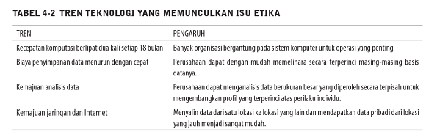
© Pearson Education 2012

Slide 12
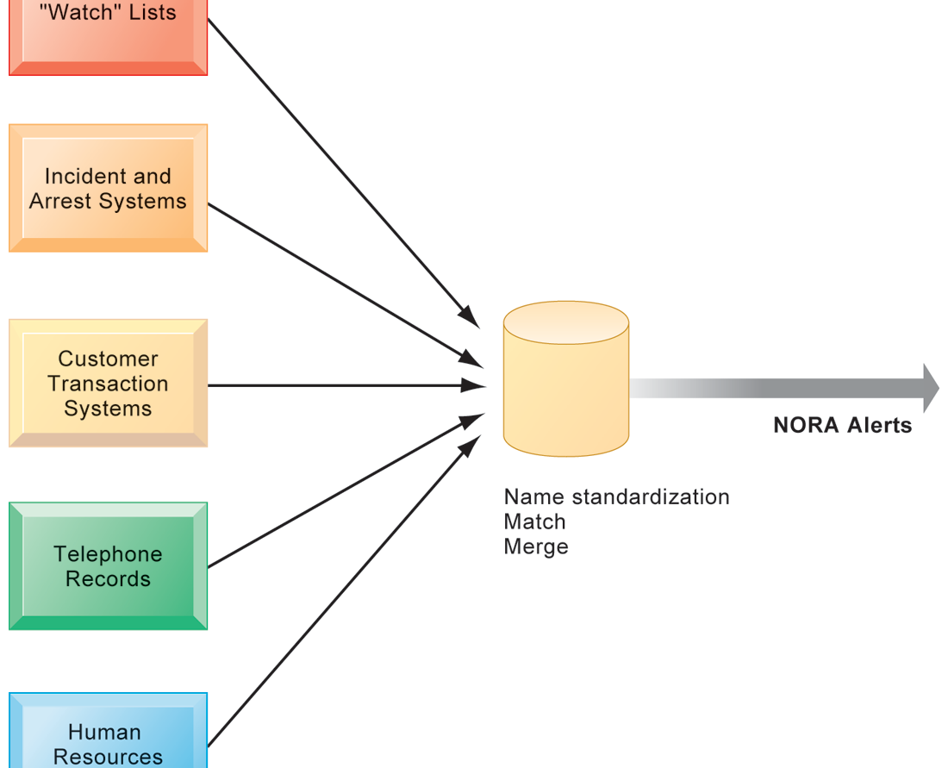
CHAPTER 4: ETHICAL AND SOCIAL ISSUES IN
INFORMATION SYSTEMS
Understanding Ethical and Social Issues Related to Systems
NONOBVIOUS RELATIONSHIP AWARENESS (NORA)
NORA technology can take information about people from disparate sources and find obscure, nonobvious relationships. It might discover, for example, that an applicant for a job at a casino shares a telephone number with a known criminal and issue an alert to the hiring manager.
FIGURE 4-2
© Pearson Education 2012
Notes:
Explain that NORA is used by both the government and the private sector for its profiling capabilities. Ask students to provide potential examples of NORA (other than the one mentioned in the caption) for both governmental and business purposes. One such example might be an airline identifying potential terrorists attempting to board a plane. Another might government identifying potential terrorists by monitoring phone calls.

Slide 13
CHAPTER 4: ETHICAL AND SOCIAL ISSUES IN
INFORMATION SYSTEMS
Ethics in an Information Society
Basic concepts for ethical analysis
  Responsibility:
    Accepting the potential costs, duties, and obligations for decisions
  Accountability:
    Mechanisms for identifying responsible parties
  Liability:
    Permits individuals (and firms) to recover damages done to them
  Due process:
    Laws are well known and understood, with an ability to appeal to higher authorities
© Pearson Education 2012
Notes:
Explain that information systems do not exist in a vacuum and that these concepts are instrumental in understanding the impact of systems and measuring their success. Ask students why liability and due process are such important ethical concepts. (A rough answer would be that they provide recourse to individuals negatively effected by mismanagement of information systems, providing incentive to ‘play by the rules’.)

Slide 14
CHAPTER 4: ETHICAL AND SOCIAL ISSUES IN
INFORMATION SYSTEMS
Ethics in an Information Society
Ethical analysis: A five-step process
  Identify and clearly describe the facts
  Define the conflict or dilemma and identify the higher-order values involved
  Identify the stakeholders
  Identify the options that you can reasonably take
  Identify the potential consequences of your options
© Pearson Education 2012
Notes:
Do students believe that any aspect of ethical analysis is lacking from this process? If so, what? Can students offer a brief example of an ethical dilemma and how they would resolve it using this process? One class exercise is to work with students to identify an ethical situation they are aware of, or that may have been in the news. Then, go through the ethical analysis described in the slide to illustrate the process of analyzing an ethical situation.

Slide 15
CHAPTER 4: ETHICAL AND SOCIAL ISSUES IN
INFORMATION SYSTEMS
Ethics in an Information Society
Six Candidate Ethical Principles
  Golden Rule
    Do unto others as you would have them do unto you
  Immanuel Kant’s Categorical Imperative
    If an action is not right for everyone to take, it is not right for anyone
  Descartes’ Rule of Change
    If an action cannot be taken repeatedly, it is not right to take at all
© Pearson Education 2012
Notes:
This slide and the next review six traditional ethical principles. Ensure students understand the difference between the categorical imperative and the rule of change. Briefly, the difference is that the categorical imperative spans the entirety of the populace, while the rule of change applies to the decisions of one person over time. For example, the categorical imperative applies to an employee who tries to steal money from his employer. He shouldn’t do this, because if all employees attempted to do so, the company would fail. The rule of change applied to the same situation might run as follows: while the employee’s stealing one dollar from the company would not lead to any true problem, repeatedly stealing one dollar, or stealing a lot of dollars, would be unacceptable and ultimately lead to the destruction of the company.

Slide 16
CHAPTER 4: ETHICAL AND SOCIAL ISSUES IN
INFORMATION SYSTEMS
Ethics in an Information Society
Six Candidate Ethical Principles (cont.)
  Utilitarian Principle
    Take the action that achieves the higher or greater value
  Risk Aversion Principle
    Take the action that produces the least harm or least potential cost
  Ethical “no free lunch” Rule
    Assume that virtually all tangible and intangible objects are owned by someone unless there is a specific declaration otherwise
© Pearson Education 2012
Notes:
How does the “no free lunch” rule relate to copyrights, patents, and trademarks? (These concepts are discussed in later slides.)
Explain that the appearance of unethical behavior is as harmful as actual unethical behavior at times, so adherence to these principles are critical. In an age of “open software” how does the principle of “no free lunch” work out?

Slide 17
CHAPTER 4: ETHICAL AND SOCIAL ISSUES IN
INFORMATION SYSTEMS
Ethics in an Information Society
Professional codes of conduct
  Promulgated by associations of professionals
    E.g. AMA, ABA, AITP, ACM
  Promises by professions to regulate themselves in the general interest of society
Real-world ethical dilemmas
  One set of interests pitted against another
  E.g. Right of company to maximize productivity of workers vs. workers right to use Internet for short personal tasks
© Pearson Education 2012
Notes:
Other ethical dilemmas include companies trying to use new systems to reduce the size of their workforce, such as telephone companies using automated systems to reduce the need for human operators. Emphasize that in cases like these, right and wrong are not clearly defined, but instead, contrasting values are at odds with one another (companies value productivity, employees value their work).

Slide 18
CHAPTER 4: ETHICAL AND SOCIAL ISSUES IN
INFORMATION SYSTEMS
The Moral Dimensions of Information Systems
Privacy:
  Claim of individuals to be left alone, free from surveillance or interference from other individuals, organizations, or state. Claim to be able to control information about yourself
In U.S., privacy protected by:
  First Amendment (freedom of speech)
  Fourth Amendment (unreasonable search and seizure)
  Additional federal statues (e.g. Privacy Act of 1974)
© Pearson Education 2012
Notes:
Do students believe that there are sufficient protections for privacy in law? If not, what are possible methods of developing appropriate privacy protections? Table 4-3 in the text lists a variety of other laws affecting both the government and private institutions, but few areas of the private sector are as well regulated with respect to privacy. Do an in-class poll and ask students who among them feel they can control the use of their personal information on the Internet. You should get no one raising their hand.

Slide 19
CHAPTER 4: ETHICAL AND SOCIAL ISSUES IN
INFORMATION SYSTEMS
The Moral Dimensions of Information Systems
Fair information practices:
  Set of principles governing the collection and use of information
  Basis of most U.S. and European privacy laws
  Based on mutuality of interest between record holder and individual
  Restated and extended by FTC in 1998 to provide guidelines for protecting online privacy
  Used to drive changes in privacy legislation
    COPPA
    Gramm-Leach-Bliley Act
    HIPAA
© Pearson Education 2012
Notes:
Explain what is meant by a ‘mutuality of interest between record holder and individual.’ (Briefly, the individual wants to engage in a transaction, and the record holder needs information about the individual to support the transaction – both are interested parties in the transaction.)

Slide 20
CHAPTER 4: ETHICAL AND SOCIAL ISSUES IN
INFORMATION SYSTEMS
The Moral Dimensions of Information Systems
FTC FIP principles:
  Notice/awareness (core principle)
  Choice/consent (core principle)
  Access/participation
  Security
  Enforcement
© Pearson Education 2012
Notes:
These five Fair Information Practices provide the foundation for all privacy legislation in the United States, and much of Europe. You can ask students or explain what each means: (1) Notice/awareness: Web sites must disclose practices before collecting data; (2) Choice/consent: Consumers must be able to choose how information is used for secondary purposes; (3) Access/participation: Consumers must be able to review, contest accuracy of personal data; (4) Security: Data collectors must take steps to ensure accuracy, security of personal data; (5) Enforcement: There must be a mechanism to enforce FIP principles
In addition, you might go to a popular Web site, such as bestbuy.com, find its privacy policy, and see how well the site conforms to the principles above. Chances are good that the Web site you choose will have several statements in their policies which permit them to do anything they want with personal information. Also, do a search on “FTC privacy” and go to one of the reports listed. A search on “FTC behavioral targeting” also produces many fine reports on the topic.

Slide 21
CHAPTER 4: ETHICAL AND SOCIAL ISSUES IN
INFORMATION SYSTEMS
The Moral Dimensions of Information Systems
European Directive on Data Protection:
  Requires companies to inform people when they collect information about them and disclose how it will be stored and used.
  Requires informed consent of customer
  EU member nations cannot transfer personal data to countries with no similar privacy protection (e.g. U.S.)
  U.S. businesses use safe harbor framework
    Self-regulating policy to meet objectives of government legislation without involving government regulation or enforcement.
© Pearson Education 2012
Notes:
EU protections of privacy are far more powerful than the United States because they require informed consent before a firm can do anything with personal information besides support the transaction at hand. In Europe, there is no junk postal mail for instance because advertising firms are prohibited from using personal information obtained from third parties, and without the consent of the individual.

Slide 22
CHAPTER 4: ETHICAL AND SOCIAL ISSUES IN
INFORMATION SYSTEMS
The Moral Dimensions of Information Systems
Internet Challenges to Privacy:
  Cookies
    Tiny files downloaded by Web site to visitor’s hard drive to help identify visitor’s browser and track visits to site
    Allow Web sites to develop profiles on visitors
  Web beacons/bugs
    Tiny graphics embedded in e-mail and Web pages to monitor who is reading message
  Spyware
    Surreptitiously installed on user’s computer
    May transmit user’s keystrokes or display unwanted ads
Google’s collection of private data; behavioral targeting
© Pearson Education 2012
Notes:
What are students attitudes towards these technologies? Emphasize that cookies can be useful at trusted sites, but perhaps invasive at others. Have students had any experience with spyware or Web bugs on their own computers? Discuss how behavioral targeting amasses information on web users. Ask students why behavioral targeting could pose ethical issues? Can mistakes be made in behavioral targeting? Should private companies own more personal data on individuals than governments? Should the government keep track of what personal private information firms collect?

Slide 23
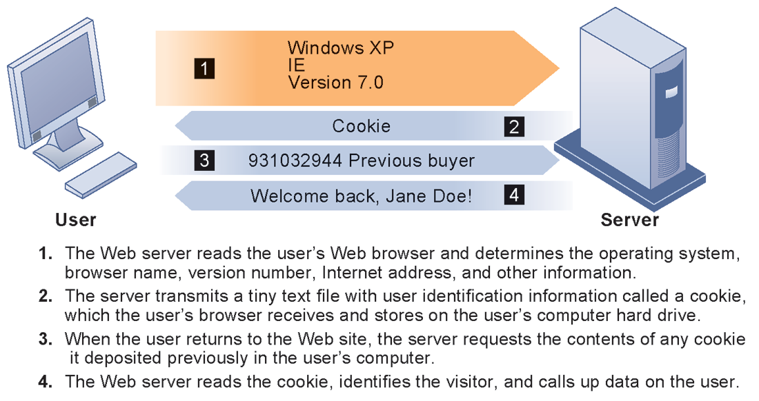
CHAPTER 4: ETHICAL AND SOCIAL ISSUES IN
INFORMATION SYSTEMS
The Moral Dimensions of Information Systems
HOW COOKIES IDENTIFY WEB VISITORS
FIGURE 4-3
Cookies are written by a Web site on a visitor’s hard drive. When the visitor returns to that Web site, the Web server requests the ID number from the cookie and uses it to access the data stored by that server on that visitor. The Web site can then use these data to display personalized information.
© Pearson Education 2012
Notes:
Ask students to pinpoint where potential privacy invasions might occur in the process shown above. Students may suggest that no real privacy violation is occurring in the figure, which is a legitimate point of view. If so, ask them how they might feel about a Web site they did not trust engaging in the displayed process.

Slide 24
CHAPTER 4: ETHICAL AND SOCIAL ISSUES IN
INFORMATION SYSTEMS
The Moral Dimensions of Information Systems
U.S. allows businesses to gather transaction information and use this for other marketing purposes
Online industry promotes self-regulation over privacy legislation
However, extent of responsibility taken varies
  Statements of information use
  Opt-out selection boxes
  Online “seals” of privacy principles
Most Web sites do not have any privacy policies
© Pearson Education 2012
Notes:
Do students believe that businesses should be pressed to provide more comprehensive privacy protections online? Explain that businesses prefer the looser regulation, but that individuals may not. Also emphasize that most individuals do not take the proper steps to ensure their own privacy in any case. Most people do not know how to protect their privacy online. Does that mean that privacy is unimportant or that people don’t care?

Slide 25
CHAPTER 4: ETHICAL AND SOCIAL ISSUES IN
INFORMATION SYSTEMS
The Moral Dimensions of Information Systems
Technical solutions
  The Platform for Privacy Preferences (P3P)
    Allows Web sites to communicate privacy policies to visitor’s Web browser – user
    User specifies privacy levels desired in browser settings
    E.g. “medium” level accepts cookies from first-party host sites that have opt-in or opt-out policies but rejects third-party cookies that use personally identifiable information without an opt-in policy
© Pearson Education 2012
Notes:
Explain that P3P is a standard of privacy intended to provide Web surfers more information about the sites they visit. Also explain that P3P is not universal, and that many sites are not members of the World Wide Web Consortium, which uses P3P.

Slide 26
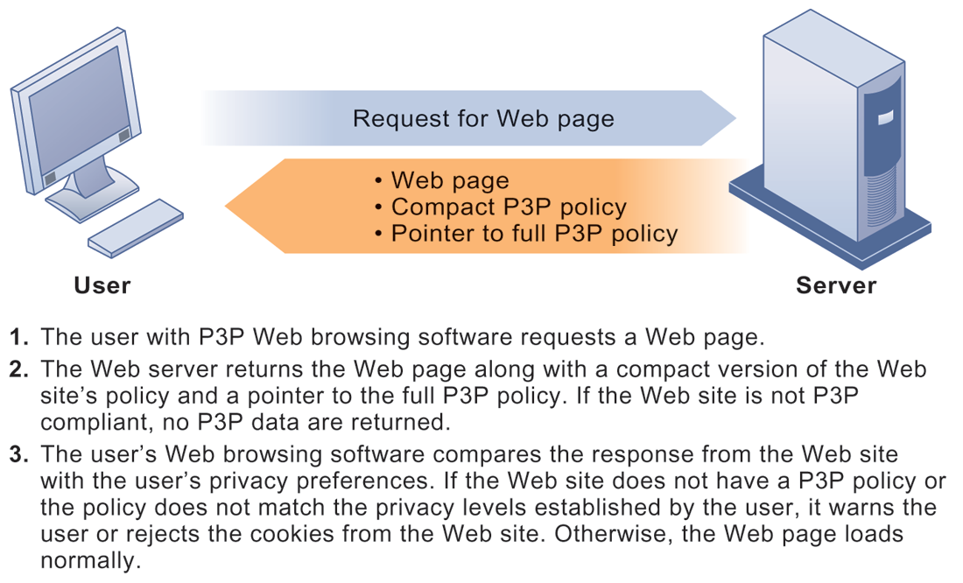
CHAPTER 4: ETHICAL AND SOCIAL ISSUES IN
INFORMATION SYSTEMS
The Moral Dimensions of Information Systems
THE P3P STANDARD
FIGURE 4-4
P3P enables Web sites to translate their privacy policies into a standard format that can be read by the user’s Web browser software. The browser software evaluates the Web site’s privacy policy to determine whether it is compatible with the user’s privacy preferences.
© Pearson Education 2012
Notes:
Have students configured their own privacy preferences in such a way that they see messages like this at any point? If not, do they care? Are they concerned about the privacy policies of any of the sites they visit? (Students may be reluctant to answer this question!)

Slide 27
CHAPTER 4: ETHICAL AND SOCIAL ISSUES IN
INFORMATION SYSTEMS
The Moral Dimensions of Information Systems
Property rights: Intellectual property
  Intellectual property: Intangible property of any kind created by individuals or corporations
  Three main ways that protect intellectual property
    Trade secret: Intellectual work or product belonging to business, not in the public domain
    Copyright: Statutory grant protecting intellectual property from being copied for the life of the author, plus 70 years
    Patents: Grants creator of invention an exclusive monopoly on ideas behind invention for 20 years
© Pearson Education 2012
Notes:
Do students believe that the property rights guaranteed by trade secrets, copyrights, and patents are strong enough to avoid the theft of intellectual property online? Give an example of a trade secret (the formula for Coke; a method of doing business or business process). Give an example of a copyright (which could include the copyright of an online business process like Amazon’s One Click shopping). And give an example of a patent.

Slide 28
CHAPTER 4: ETHICAL AND SOCIAL ISSUES IN
INFORMATION SYSTEMS
The Moral Dimensions of Information Systems
Challenges to intellectual property rights
  Digital media different from physical media (e.g. books)
    Ease of replication
    Ease of transmission (networks, Internet)
    Difficulty in classifying software
    Compactness
    Difficulties in establishing uniqueness
Digital Millennium Copyright Act (DMCA)
  Makes it illegal to circumvent technology-based protections of copyrighted materials
© Pearson Education 2012
Notes:
Students may be unwilling to admit to infringing upon intellectual property rights themselves, but ask them whether they are familiar with the Internet and its ability to bypass intellectual property protections. Do they believe that legislation like the DMCA is having any effect? How many have friends who download “free” music from P2P sights? Free videos?

Slide 29
CHAPTER 4: ETHICAL AND SOCIAL ISSUES IN
INFORMATION SYSTEMS
The Moral Dimensions of Information Systems
Accountability, Liability, Control
  Computer-related liability problems
    If software fails, who is responsible?
      If seen as part of machine that injures or harms, software producer and operator may be liable
      If seen as similar to book, difficult to hold author/publisher responsible
      What should liability be if software seen as service? Would this be similar to telephone systems not being liable for transmitted messages?
© Pearson Education 2012
Notes:
Using the example from the text, who do students consider to be the liable party for the incident involving TD Bank customers whose paychecks were denied due to an operating error at the bank’s computer center? Is it the designers of the systems at the center? The bank itself as a corporate entity? Is there no liability involved? If there is no liability, why would TD Bank try to prevent these events in the future? Explain that it is difficult to ascribe liability to software developers for the same reason that it is difficult to ascribe a publisher liability for the effects of a book. Does this analogy hold true? There are no guarantees that either books or software are fool proof. When the advice in books is followed, or software used, either could kill you.

Slide 30
CHAPTER 4: ETHICAL AND SOCIAL ISSUES IN
INFORMATION SYSTEMS
The Moral Dimensions of Information Systems
System Quality: Data Quality and System Errors
  What is an acceptable, technologically feasible level of system quality?
    Flawless software is economically unfeasible
  Three principal sources of poor system performance:
    Software bugs, errors
    Hardware or facility failures
    Poor input data quality (most common source of business system failure)
© Pearson Education 2012
Notes:
Do students have any opinion about when software is ‘good enough?’ Does it depend on the particular product? For example, distinguish between software used by air traffic controllers and software used for word processing. Do students believe that there are different levels of acceptable quality for these products?

Slide 31
CHAPTER 4: ETHICAL AND SOCIAL ISSUES IN
INFORMATION SYSTEMS
The Moral Dimensions of Information Systems
Quality of life: Equity, access, and boundaries
  Negative social consequences of systems
    Balancing power: Although computing power decentralizing, key decision-making remains centralized
    Rapidity of change: Businesses may not have enough time to respond to global competition
    Maintaining boundaries: Computing, Internet use lengthens work-day, infringes on family, personal time
    Dependence and vulnerability: Public and private organizations ever more dependent on computer systems
© Pearson Education 2012
Notes:
Ask students whether they have witnessed any of these negative consequences first-hand. It’s likely that they know someone who has become dependent on their computer to some extent or have even experienced something similar first-hand. Which of the above consequences do students feel is the most alarming?

Slide 32
CHAPTER 4: ETHICAL AND SOCIAL ISSUES IN
INFORMATION SYSTEMS
The Moral Dimensions of Information Systems
Computer crime and abuse
  Computer crime: Commission of illegal acts through use of compute or against a computer system – computer may be object or instrument of crime
  Computer abuse: Unethical acts, not illegal
    Spam: High costs for businesses in dealing with spam
Employment:
  Reengineering work resulting in lost jobs
Equity and access – the digital divide:
  Certain ethnic and income groups in the United States less likely to have computers or Internet access
© Pearson Education 2012
Notes:
Ask students what their experience with spam is. A notable statistic is that spam accounts for over 90 percent of all business e-mail traffic and is relatively unlikely to decrease, because it is so difficult to regulate and so cheap to send. Do students believe that the end result of continuing advances in information technology will be rising unemployment and a small number of elite corporate professionals? Students may enjoy debating this idea, which is somewhat far-fetched, but conceptually stimulating.

Slide 33
CHAPTER 4: ETHICAL AND SOCIAL ISSUES IN
INFORMATION SYSTEMS
The Moral Dimensions of Information Systems
Health risks:
  Repetitive stress injury (RSI)
    Largest source is computer keyboards
    Carpal Tunnel Syndrome (CTS)
  Computer vision syndrome (CVS)
  Technostress
  Role of radiation, screen emissions, low-level electromagnetic fields
© Pearson Education 2012
Notes:
Have students encountered any of these health risks, either from personal experience or from someone they know?

